Slide 1
Fair Representations
Keith Burghardt
(Slides borrowed from Fred Morstatter) March 27, 2024

Slide 2
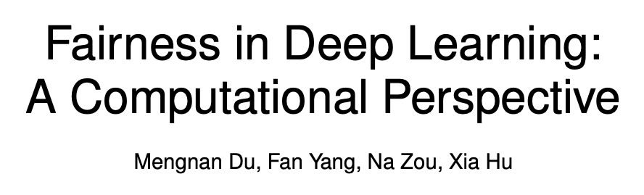

Slide 3
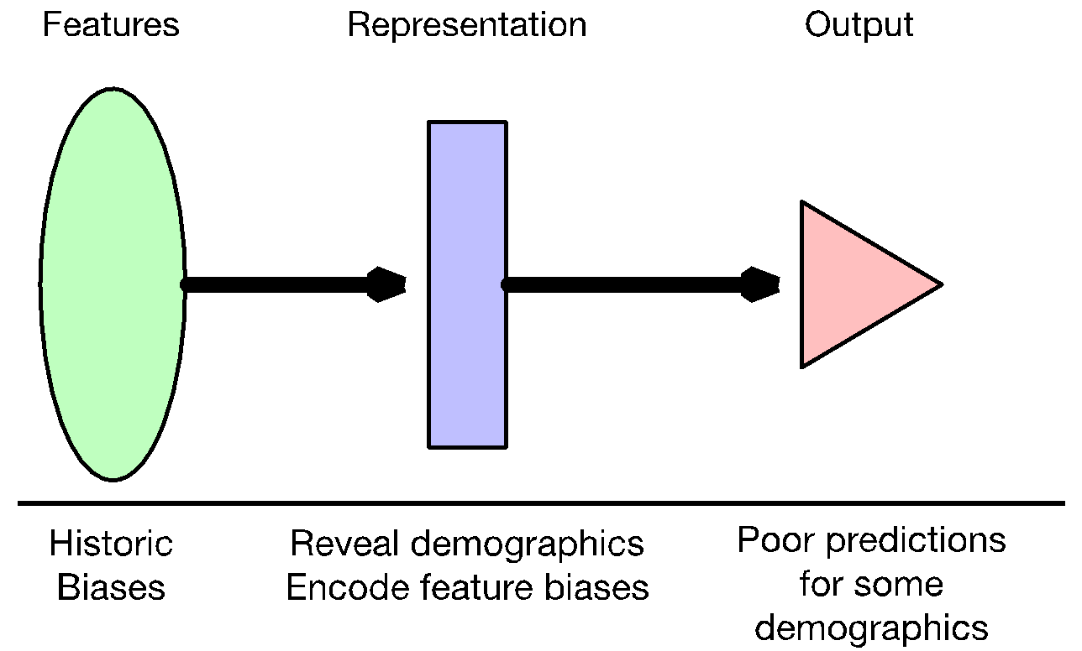

Slide 4
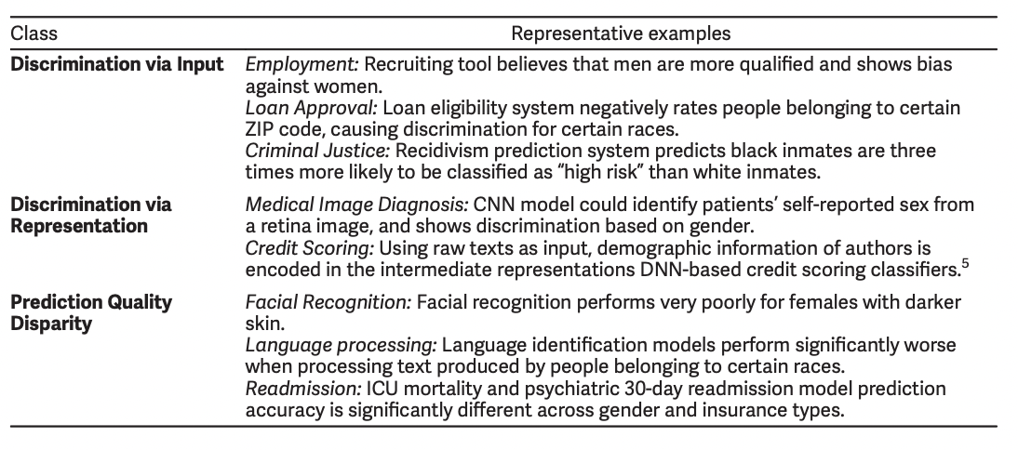
Unfairness at different levels
Du, M., Yang, F., Zou, N., & Hu, X. (2020). Fairness in deep learning: A computational perspective. IEEE Intelligent Systems, 36(4), 25-34.

Slide 5
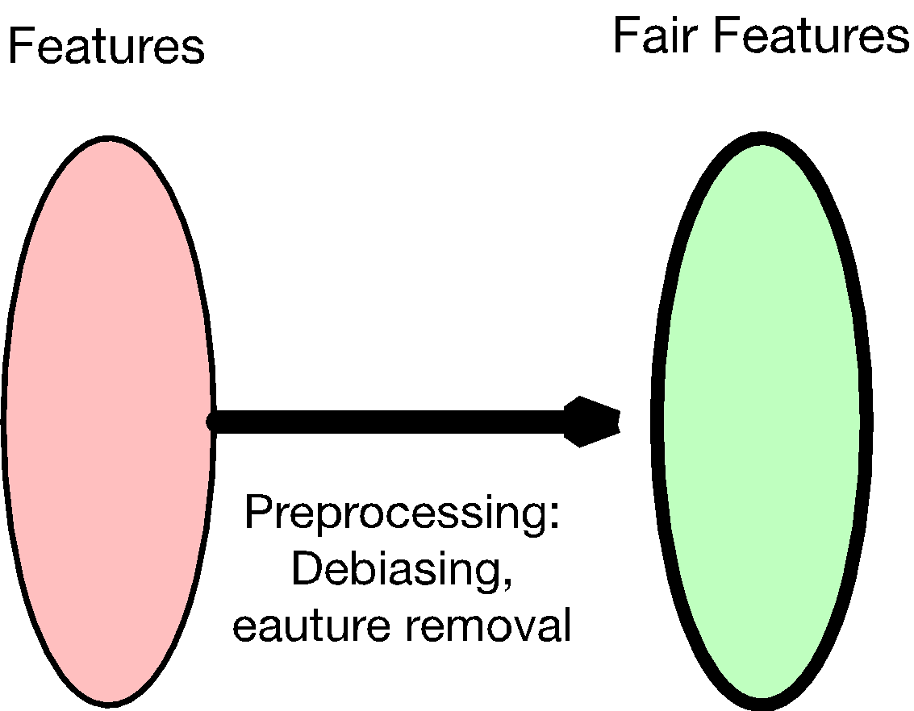
Fairer features

Slide 6
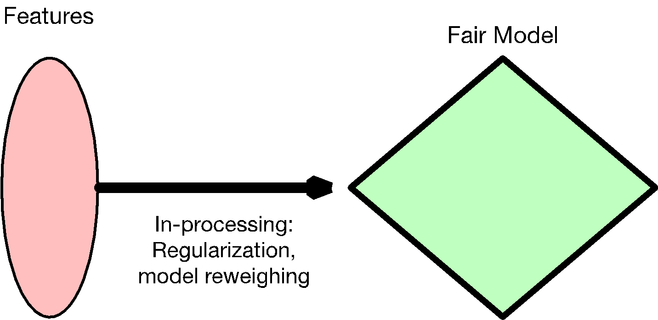
Fairer features

Slide 7
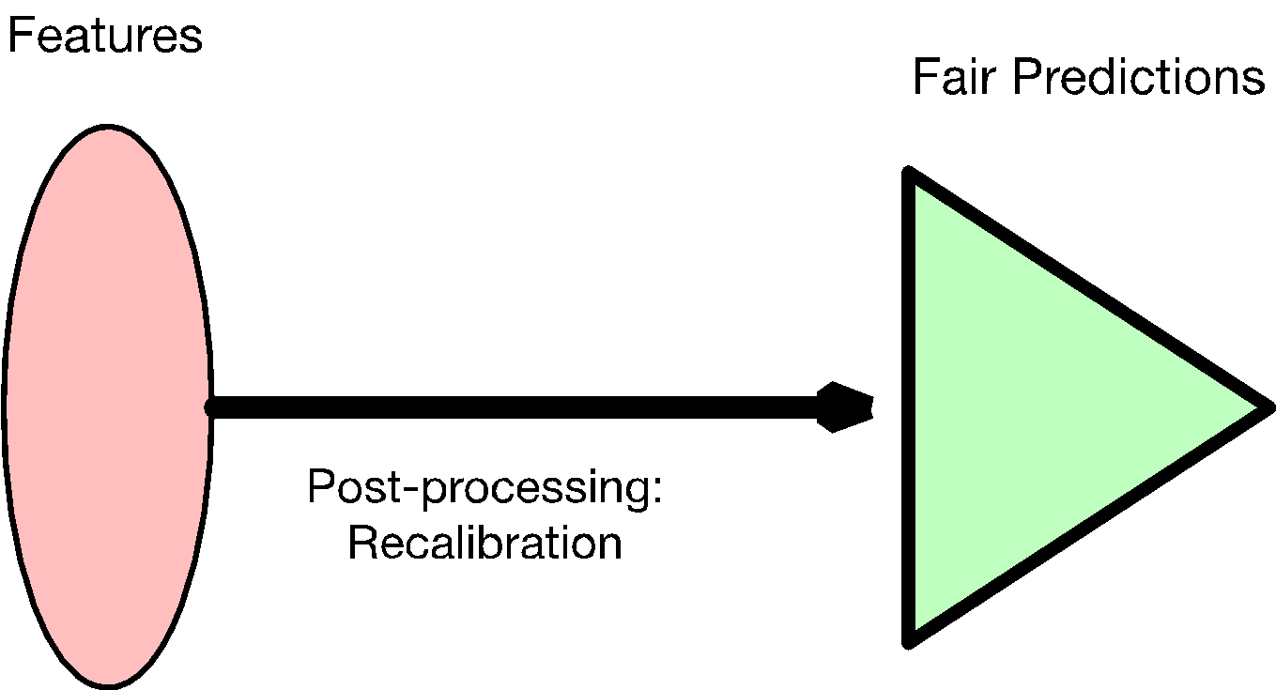
Fairer features

Slide 8
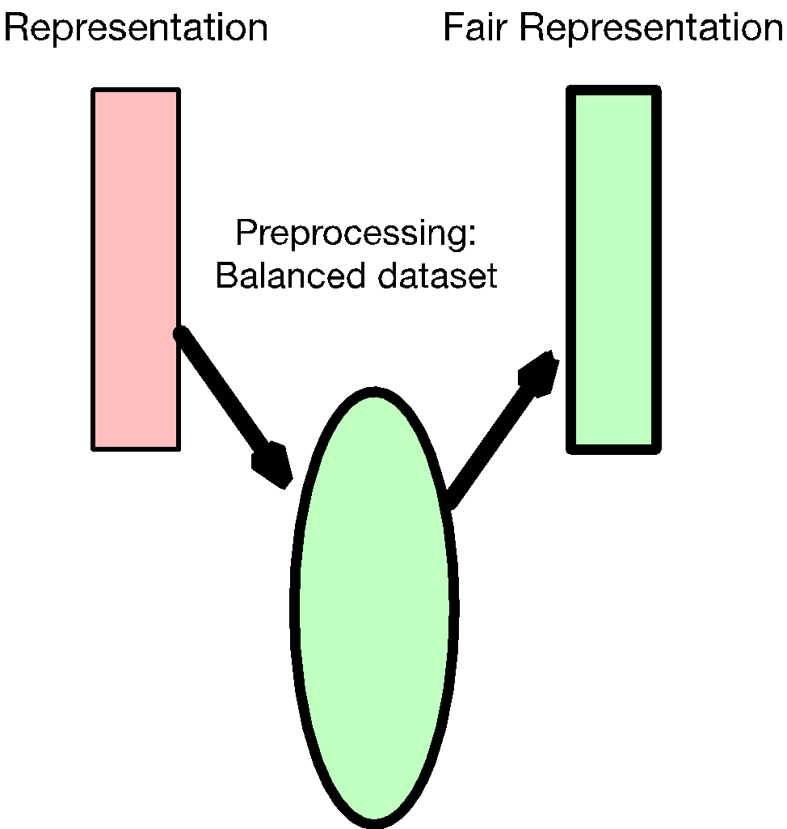
Fairer representations

Slide 9
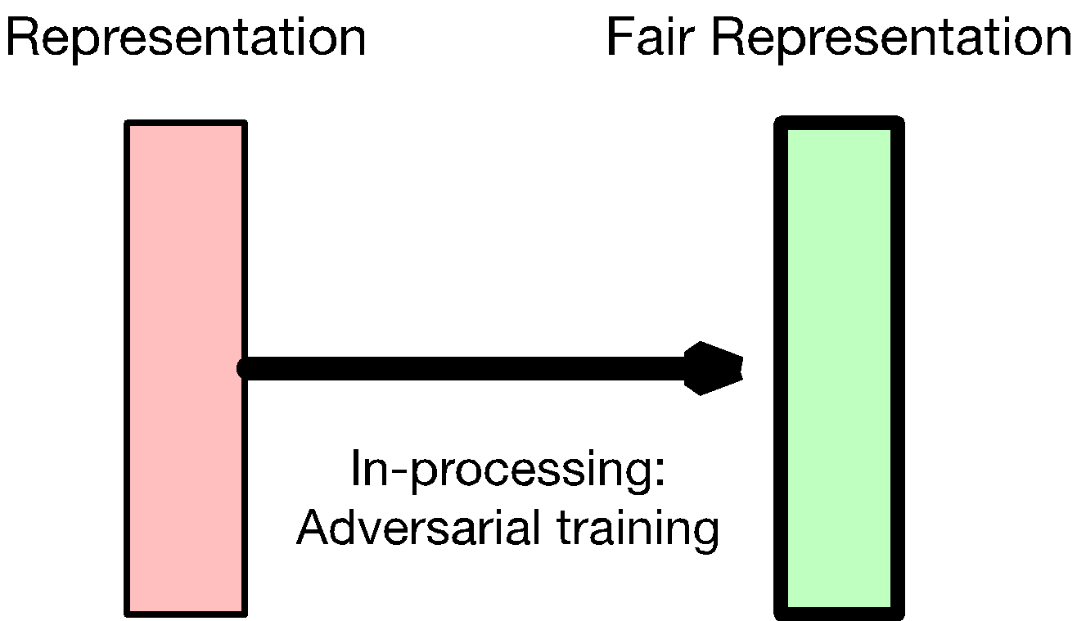
Fairer representations

Slide 10
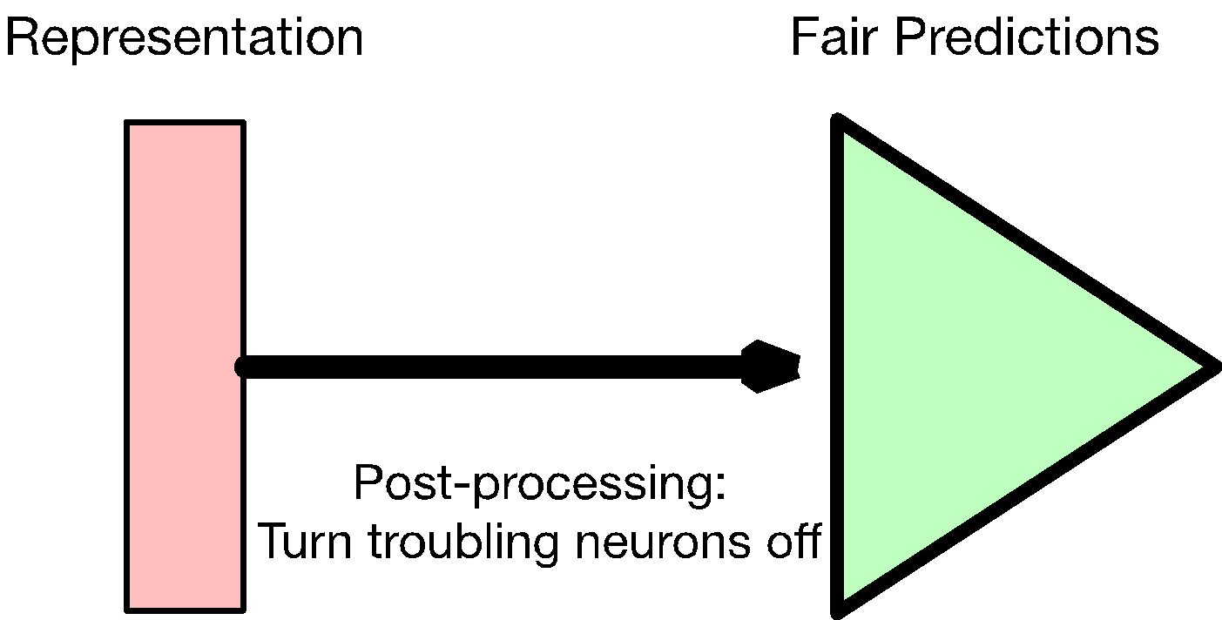
Fairer representations

Slide 11
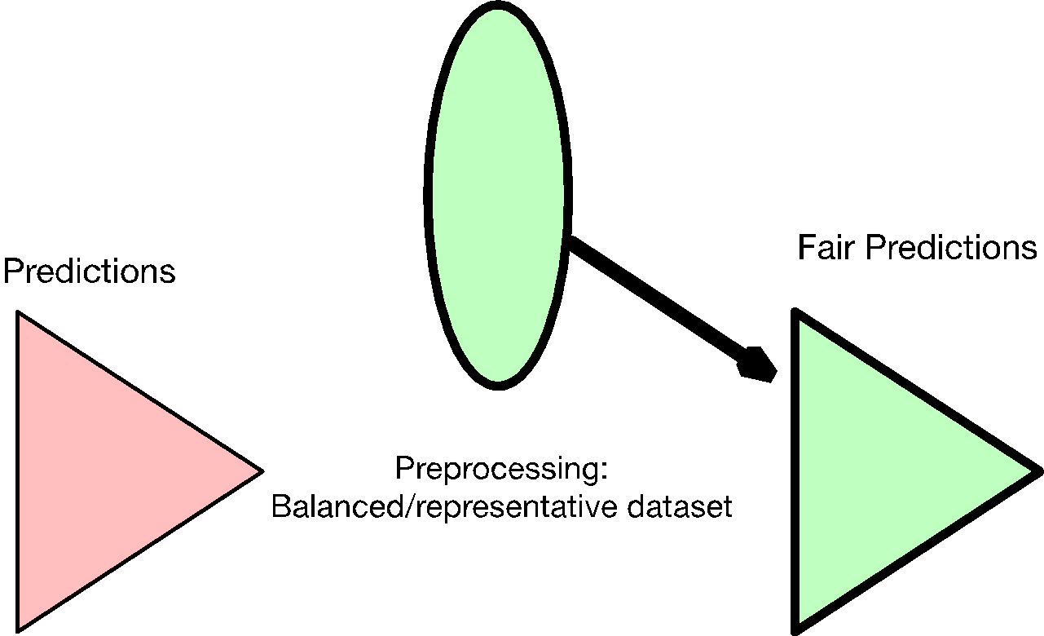
Fairer output
(g-SMOTE, etc.)

Slide 12
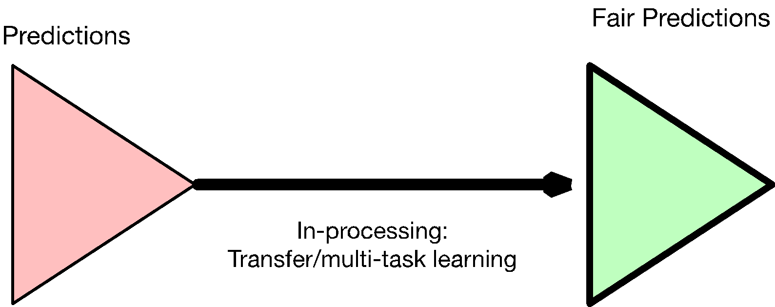
(fine-tuning)

Slide 13
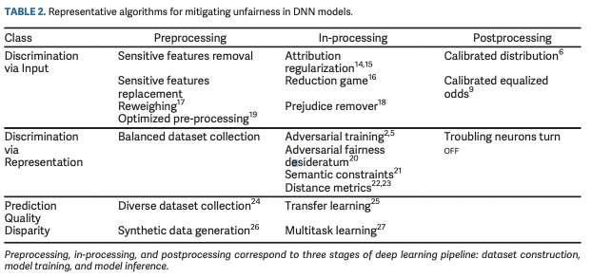

Slide 14
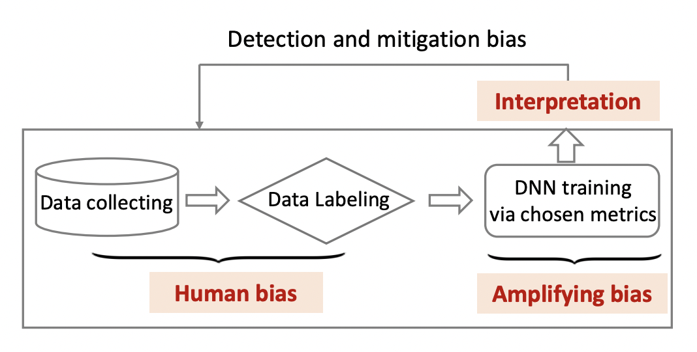
Biases within a DNN
Detecting and Mitigating Biases
Biases

Slide 15
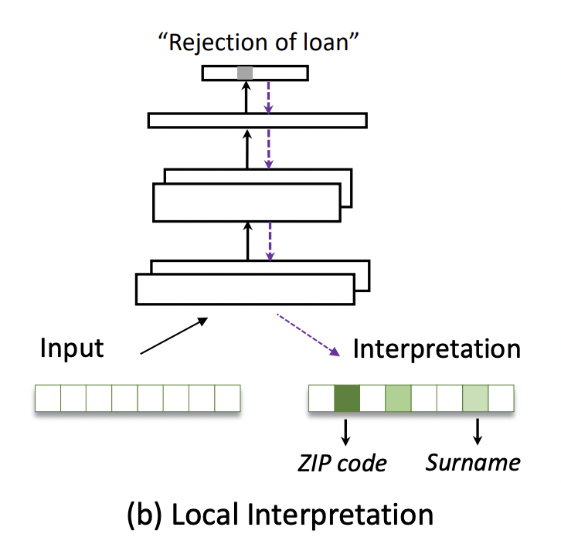
How does a model arrive at a decision?
Local interpretation:
Individual predictions may not be fair
We scrutinize each decision with interpretable AI

Slide 16
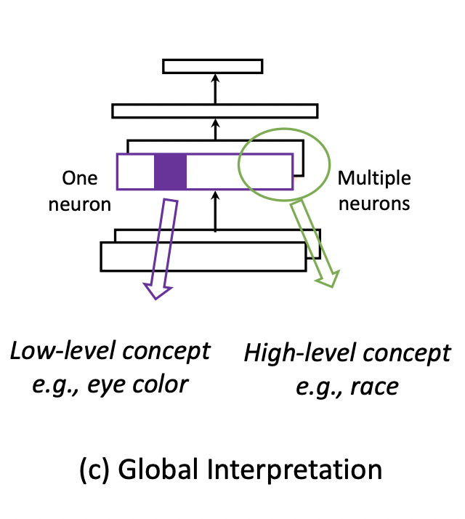
Global interpretation
Is model picking up useful info?
Or biases? e.g.,
Low-level concept like eye color to determine if someone gets a job (eye color can correlate with race)
High-level concept like representations predict race
Goal: task should not depend on race, so representations should not correlate with race

Slide 17
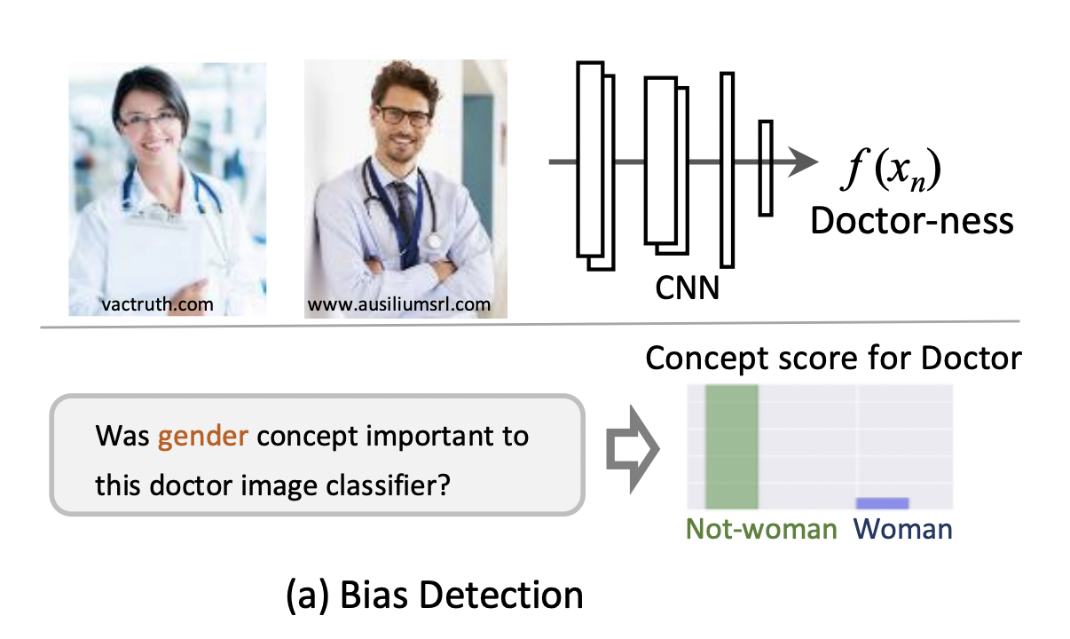

Slide 18
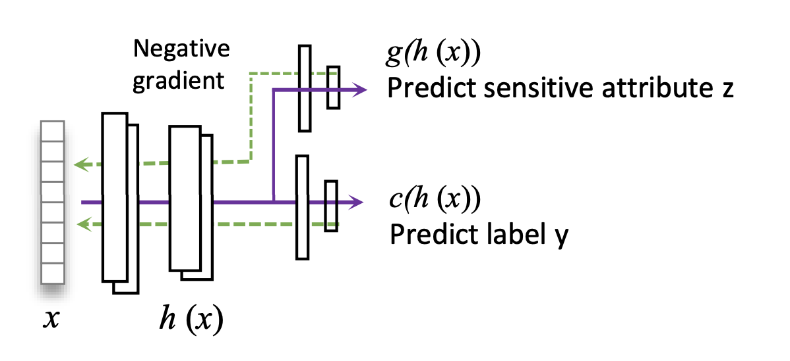
Knowing person was not a woman increased model confidence in “doctor” prediction
Discriminate towards women!
Adversarial training to remove gender could make better (fairer) model

Slide 19
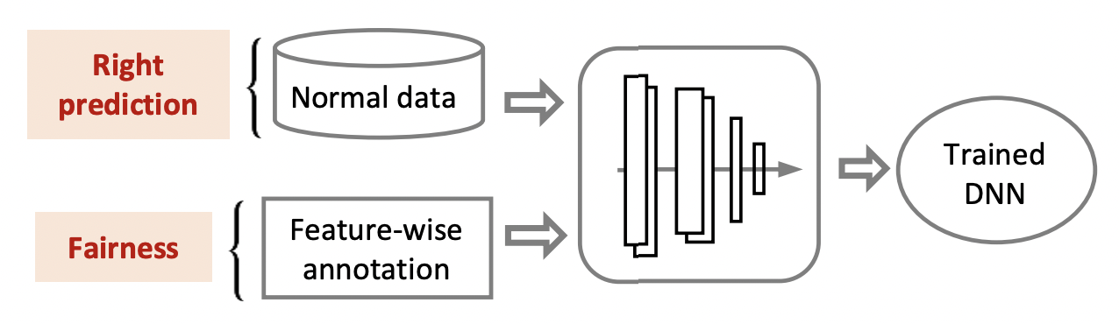
DNN interpretation to remove biases

Slide 20
DNN interpretation to remove biases
Add to loss function to disentangle association between representations and biases
‘The conversation with Malik was heartbreaking’ annotated as: [0, 0, 0, 1, 0, 0] indicating that ‘Malik’ is correlated with race, while the rest words are considered as task relevant

Slide 21
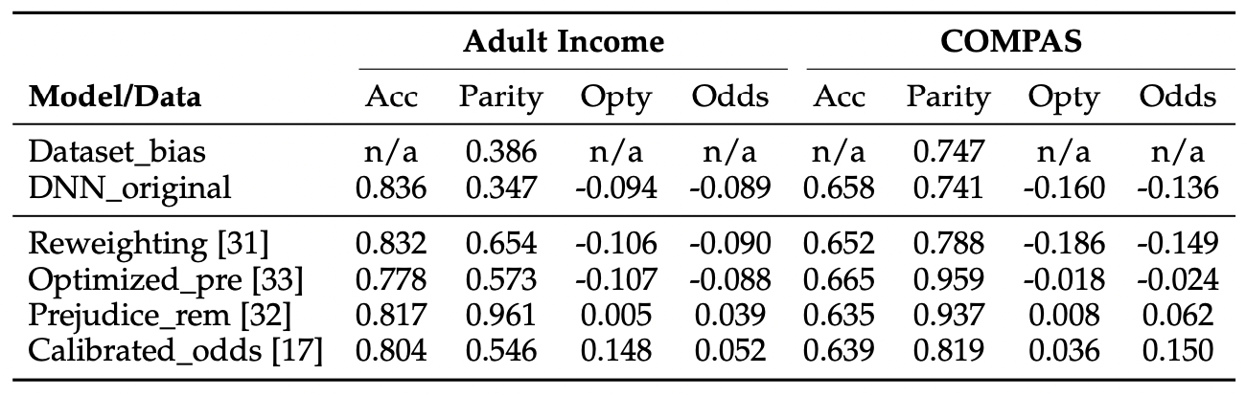
Similar accuracy, more fair

Slide 22
Aside: Adult dataset is very common
Predict income: >50K, <=50K.
Protected feature: often gender, but other attributes include: age: continuous. workclass: Private, Self-emp-not-inc, Self-emp-inc, Federal-gov, Local-gov, State-gov, Without-pay, Never-worked. fnlwgt: continuous. education: Bachelors, Some-college, 11th, HS-grad, Prof-school, Assoc-acdm, Assoc-voc, 9th, 7th-8th, 12th, Masters, 1st-4th, 10th, Doctorate, 5th-6th, Preschool. education-num: continuous. marital-status: Married-civ-spouse, Divorced, Never-married, Separated, Widowed, Married-spouse-absent, Married-AF-spouse. occupation: Tech-support, Craft-repair, Other-service, Sales, Exec-managerial, Prof-specialty, Handlers-cleaners, Machine-op-inspct, Adm-clerical, Farming-fishing, Transport-moving, Priv-house-serv, Protective-serv, Armed-Forces. relationship: Wife, Own-child, Husband, Not-in-family, Other-relative, Unmarried. race: White, Asian-Pac-Islander, Amer-Indian-Eskimo, Other, Black. sex: Female, Male. capital-gain: continuous. capital-loss: continuous. hours-per-week: continuous. native-country: United-States, Cambodia, England, Puerto-Rico, Canada, Germany, Outlying-US(Guam-USVI-etc), India, Japan, Greece, South, China, Cuba, Iran, Honduras, Philippines, Italy, Poland, Jamaica, Vietnam, Mexico, Portugal, Ireland, France, Dominican-Republic, Laos, Ecuador, Taiwan, Haiti, Columbia, Hungary, Guatemala, Nicaragua, Scotland, Thailand, Yugoslavia, El-Salvador, Trinadad&Tobago, Peru, Hong, Holand-Netherlands.

Slide 23
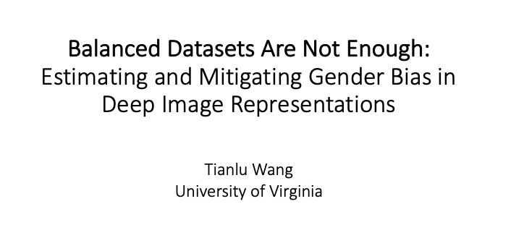

Slide 24
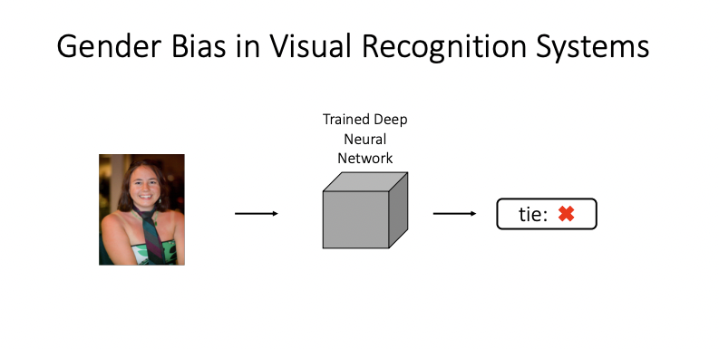

Slide 25
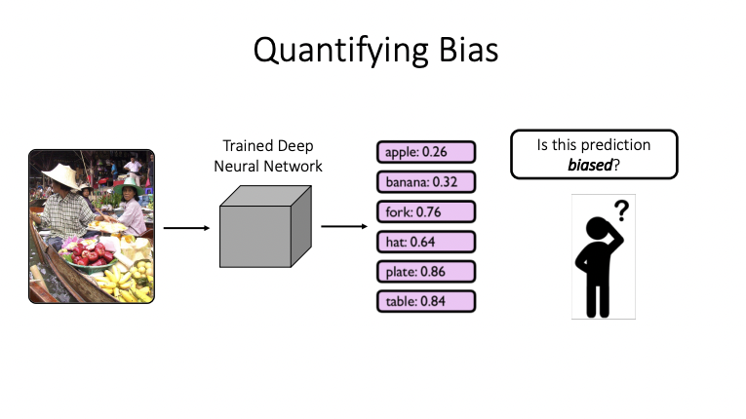

Slide 26
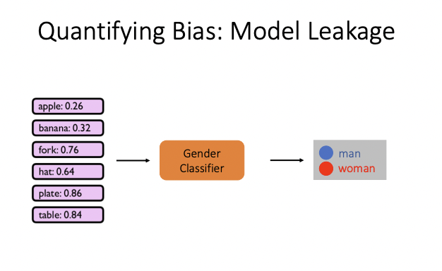

Slide 27
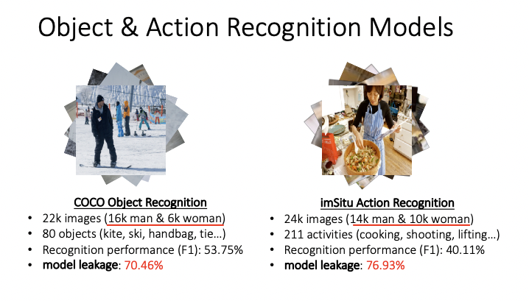

Slide 28
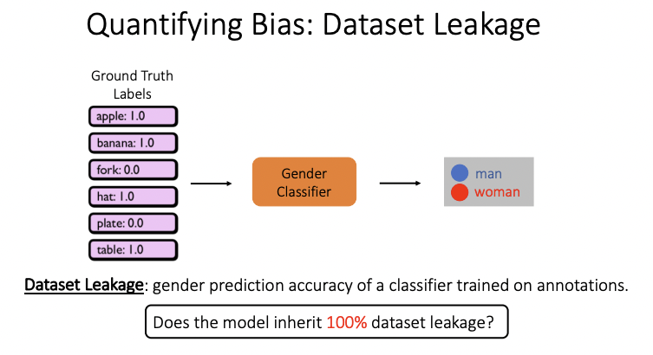

Slide 29
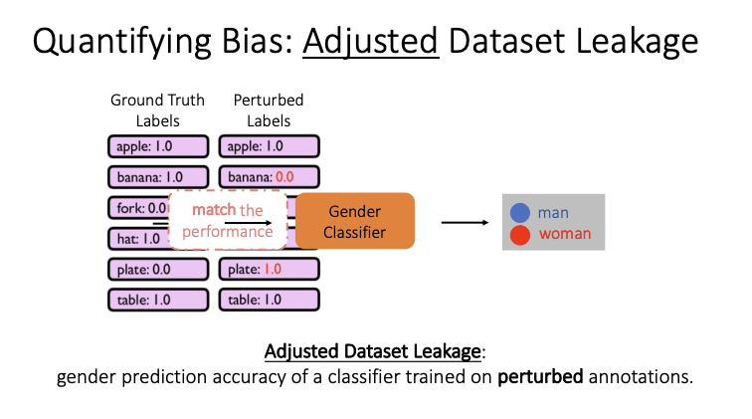
Notes:
“Randomly flip ground truth labels to reach various levels of accuracy.”

Slide 30
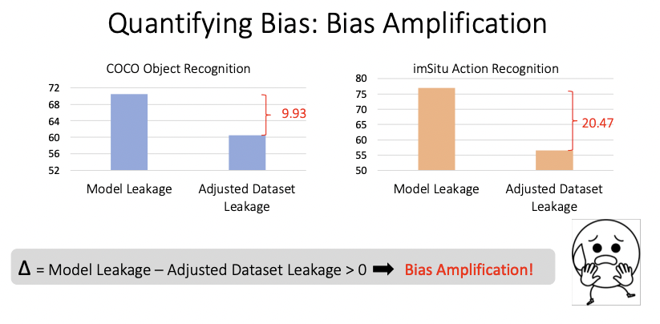

Slide 31
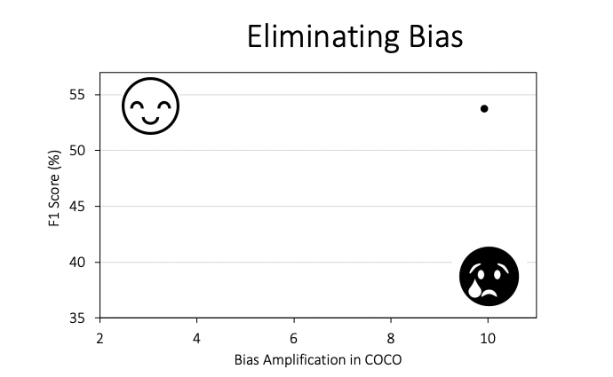

Slide 32
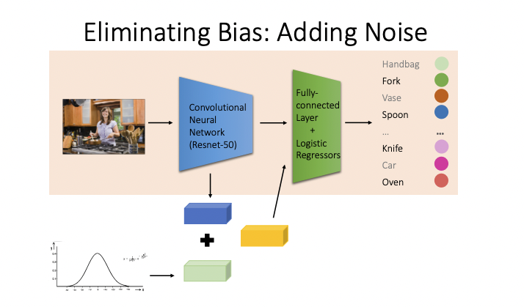

Slide 33
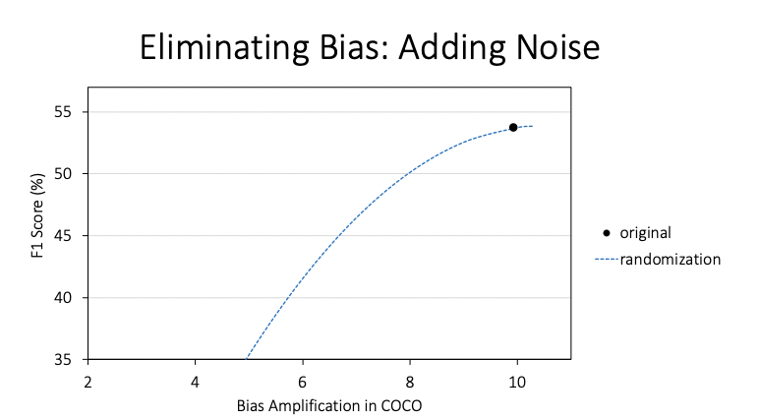

Slide 34
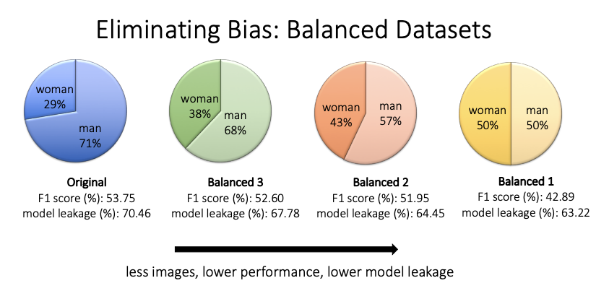

Slide 35
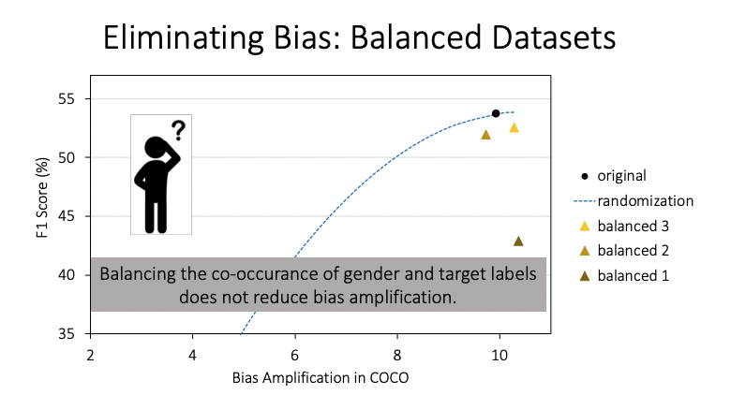

Slide 36
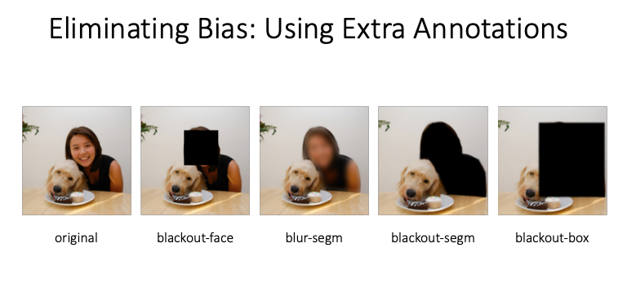

Slide 37
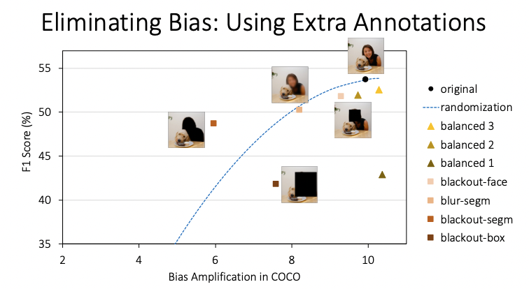

Slide 38
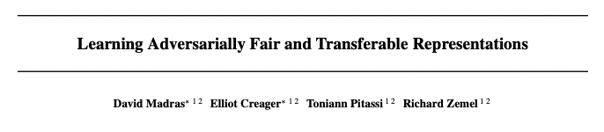
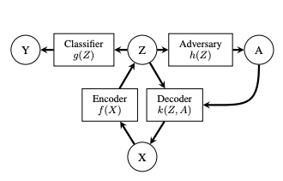
Notes:
Goals:
Z can reconstruct X
predict Y
shield A from an adversary

Slide 39
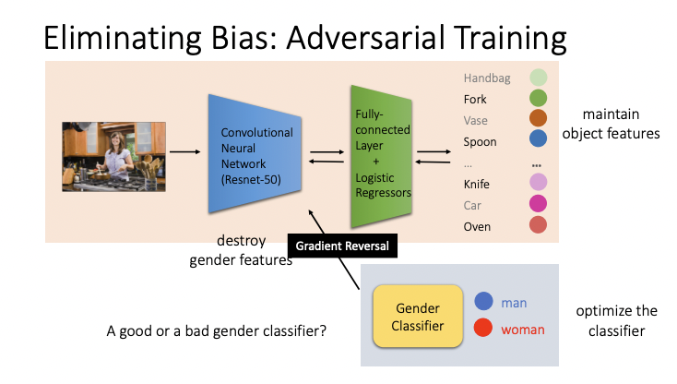

Slide 40
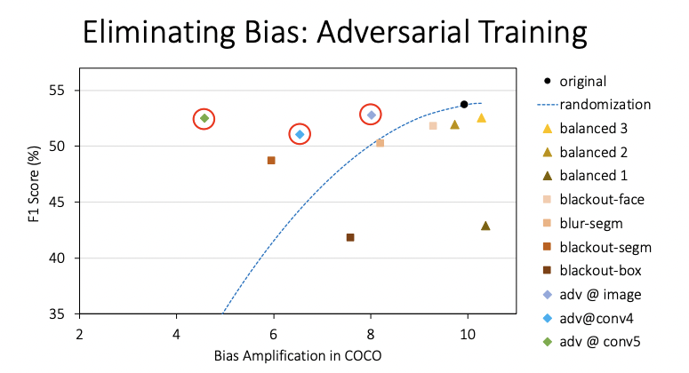
https://www.vislang.ai/genderless

Slide 41
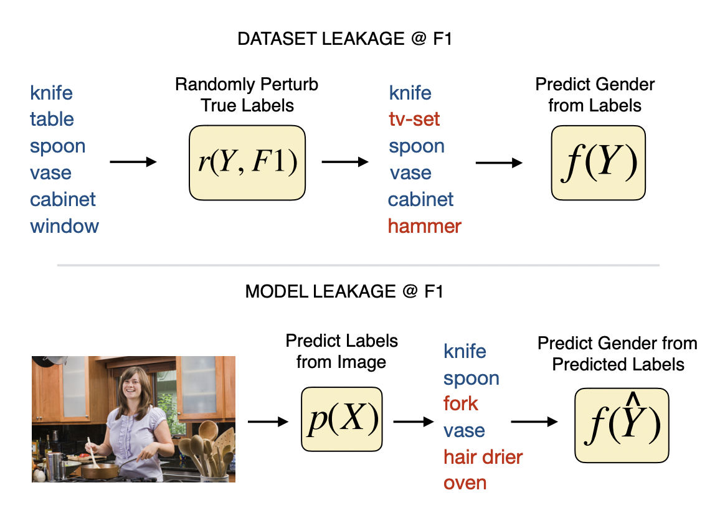

Slide 42
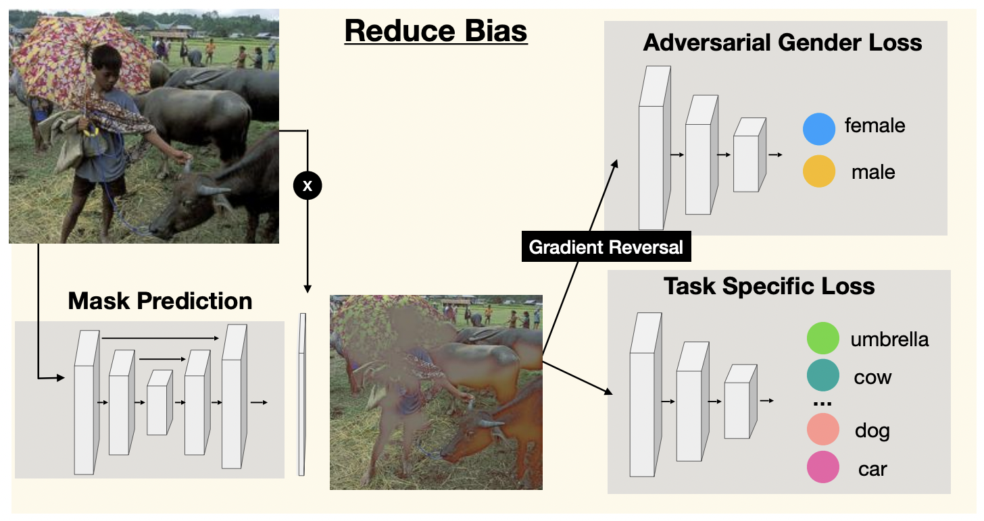

Slide 43
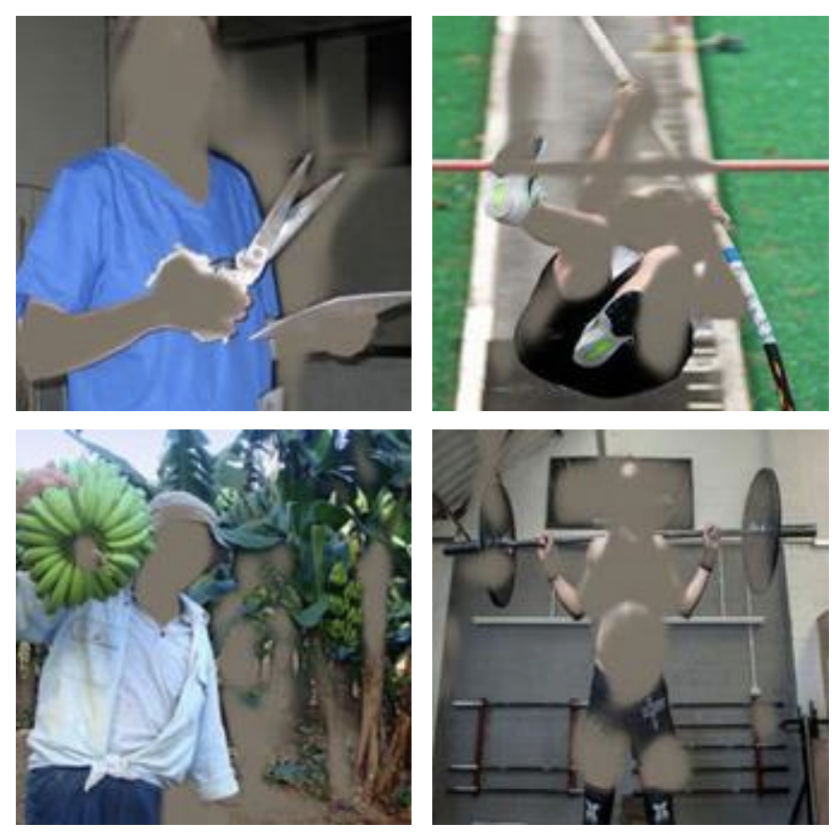

Slide 44
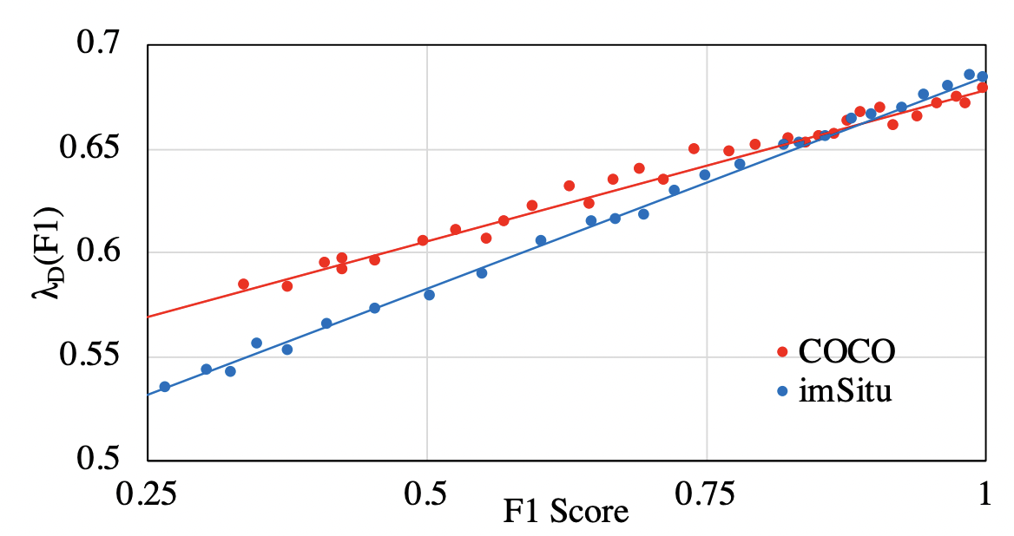

Slide 45
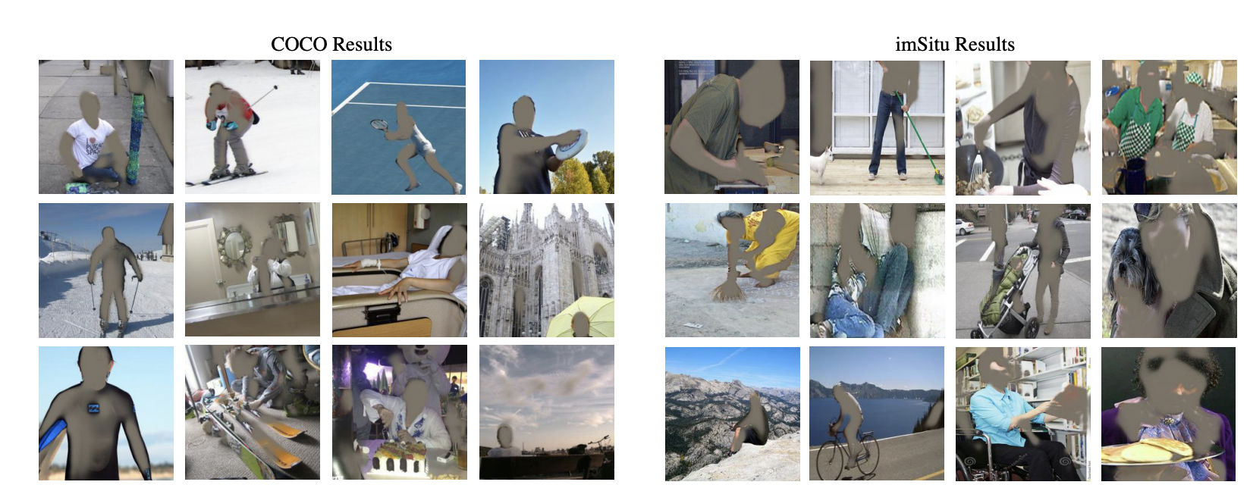

Slide 46
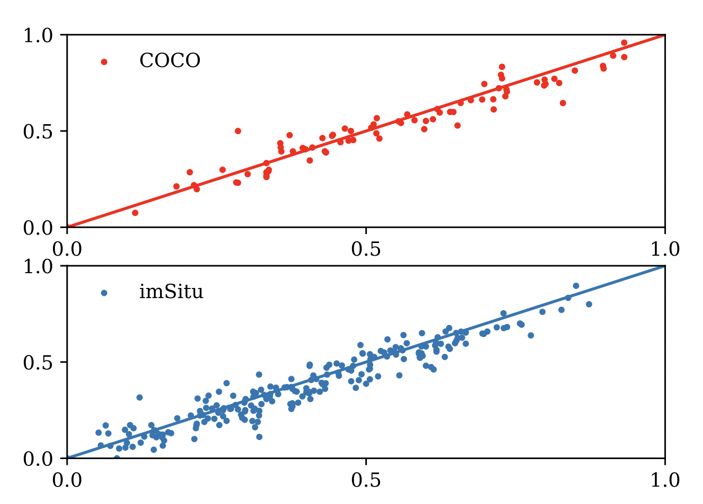

Slide 47
Text representations

Slide 48
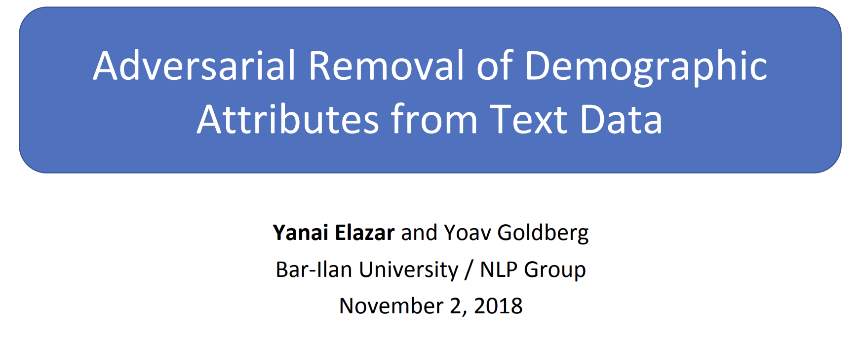
Slides: https://yanaiela.github.io/presentations/demog-text-removal-emnlp18.pdf

Slide 49
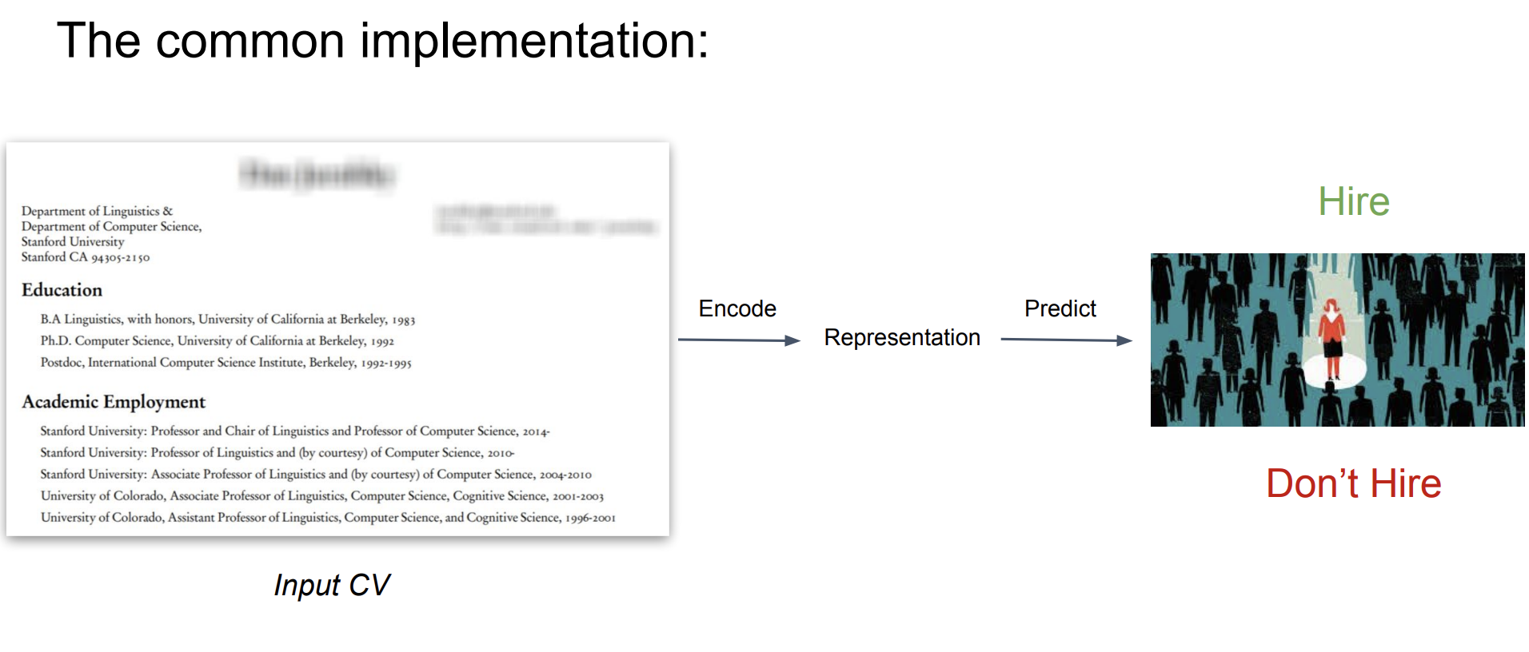

Slide 50
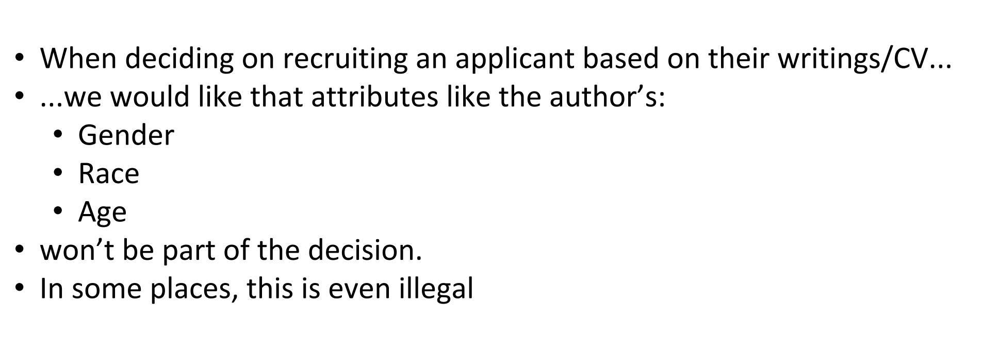

Slide 51
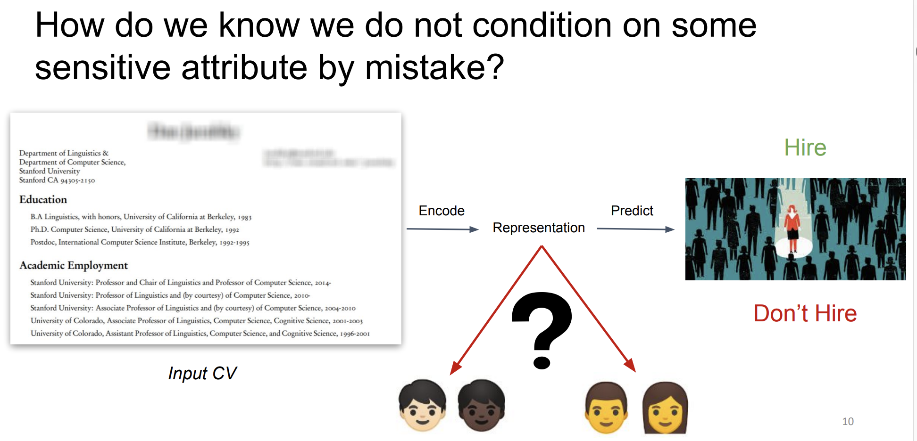

Slide 52
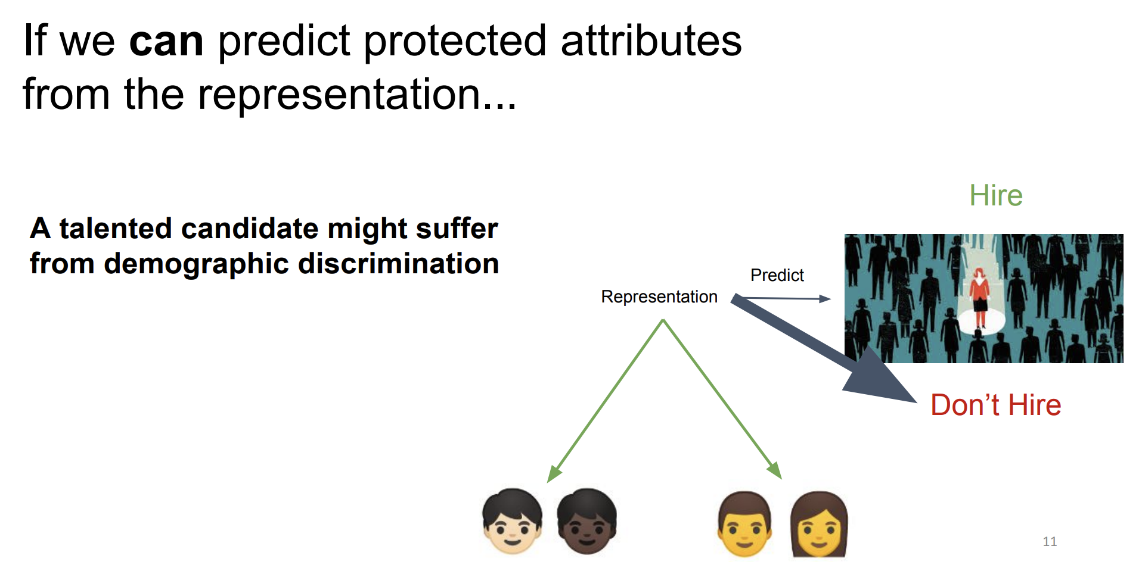

Slide 53
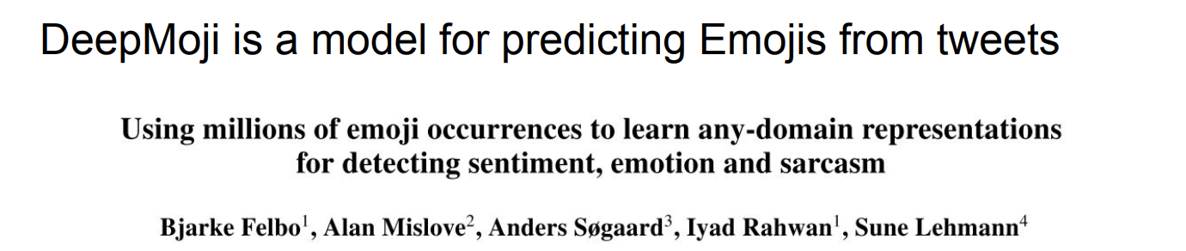
Instead of hiring, use common model of emojis

Slide 54


Slide 55


Slide 56


Slide 57


Slide 58


Slide 59


Slide 60


Slide 61


Slide 62


Slide 63


Slide 64


Slide 65


Slide 66


Slide 67


Slide 68


Slide 69


Slide 70


Slide 71

Error Analysis

Slide 72


Slide 73

“Relationship Status”
Original
Fair

Slide 74
How is fairness being satisfied?
Figure 1 (left) we can see that our method deals with the notorious problem of a husband or wife relationship status being a direct proxy for gender (Q2). Our method recognizes this across all repeats in an unsupervised manner and reduces the wife category which is associated with a negative prediction. Other categories that have less correlation with the protected characteristic, such as race, largely remain unmodified (Figure 1 (right)).

Slide 75


Slide 76


Slide 77


Slide 78


Slide 79


Slide 80



Slide 81
Research goal
post-processing bias mitigation technique by diminishing the weights of features most responsible for causing unfairness.
Data
Biosbias
Short bios of individuals
Predict occupation
UCI Adult
Census data
Outcome: income
Protected group: gender
Heritage health
Patient information
Protected group: age
task is to predict the Charleson Index (comorbidity index, which is a patient survival indicator).

Slide 82
Attention to reduce bias
In a general classification model
for each feature fk a vector representation ek of length d e is learned.
This is passed to the attention layer which produces a d e -dimensional vector representation for the sample instance i which is passed to two dense layers to get the final classification output.
The Attribution framework
has the same architecture as the general model.
One outcome is obtained through the original model and another through the model that has some attention weights zeroed.
The observed difference in accuracy and fairness measures will indicate the effect of the zeroed out features on accuracy and fairness.

Slide 83


Slide 84


Biosbias

Slide 85

Notes:
An autoencoder has two main parts: an encoder that maps the input into the code, and a decoder that maps the code to a reconstruction of the input. Could copy, but nah

Slide 86

What is a VAR
Reminder: Variational Autoencoder replicates original input based on sampled latent space

Slide 87


Slide 88


Goal
Learn an autoencoder s.t. the code vector z loses information about sensitive attributes.
Ensure that p(Z | sensitive) is indistinguishable for different values of the sensitive attribute
Maximum mean discrepancy (MMD) is a measure of distance between two distributions

Slide 89


Slide 90

VFAE creates representations with less bias
Notes:
Lighting conditions

Slide 91

Less nuisance factors
Discriminative measure for age
Accuracy on age
Adult dataset

Slide 92
Conclusion
MMD acts as a “regularizer” to remove sensitive/nuisance attributes
We have to specify these attributes/measure them in data
Not possible in general!

Slide 93
EXACERBATING ALGORITHMIC BIAS THROUGH FAIRNESS ATTACKS
Ninareh Mehrabi, Muhammad Naveed, Fred Morstatter, Aram Galstyan
University of Southern California
Information Sciences Institute
AAAI 2021
1

Slide 94
Introduction
Previous work in adversarial machine learning mostly considered and analyzed vulnerability of models with regards to accuracy.
Fairness measures are just as important as accuracy and can be attacked by the adversaries.
Thus, still there can be safety and security concerns with regards to fairness metrics in adversarial setting.
In this work, we propose two families of data poisoning attacks targeting fairness.
2

Slide 95
Overview
General Background
Adversarial Machine Learning
Adversarial Attacks
Data Poisoning Attacks
Poisoning Attacks on Fairness
Anchoring Attack
Influence Attack on Fairness
Experiments
Baselines, Datasets, and Measures
Results
Conclusion and Future Work
3

Slide 96

Adversarial Machine Learning
Adversaries and malicious users can target machine learning models and cause serious safety and security related issues.
The field of adversarial machine learning arose as a result of these observations with hopes of proposing attacks and defenses to prevent harmful consequences.
4

Slide 97

Adversarial Attacks
Adversarial attacks fall under different categories.
Evasion Attacks: These types of attacks happen during test time and the goal is to provide an example in test time that can fool the model.
Poisoning Attacks: These types of attacks happen during the training process. The goal is to train a malicious model via some poisoned data instances.
5

Slide 98

Data Poisoning Attacks
In this presentation I will focus on data poisoning attacks.
What is data poisoning attack?
One that adds, removes, or places poisoned data points during the training process that will result a malfunctioned model.
Koh, Pang Wei, Jacob Steinhardt, and Percy Liang. "Stronger data poisoning attacks break data sanitization defenses.” 2018.
6

Slide 99

Poisoning Attack Objective
The goal of the data poisoning attack as an optimization problem:
We have:
The adversary who wants to maximize a targeted loss via some poisoned points.
A set of clean and poisoned data points.
A feasible set which the adversary wishes to put its poisoned instances there to avoid detection by sanitization techniques.
Finally, the defender who wants to minimizes its loss.
7

Slide 100
Attacking Fairness
Most poisoning attacks attack accuracy only.
Fairness measures are just as important and can be attacked by adversaries.
Adversaries can attack a system with regards to fairness to skew and bias decisions in their favor or in favor of a specific group in general.
E.g., in loan giving scenario or college admission.
Adversaries can attack government agencies and degrade their values and credibility to make them appear discriminatory.
Thus, still there can be safety and security concerns with regards to fairness metrics in adversarial setting.
8

Slide 101
Our Proposed Attacks on Fairness
We propose two sets of data poisoning attacks targeted toward fairness:
Anchoring Attacks
The goal is to skew the decision boundary by placement of poisoned instances. Two types of anchoring attack:
Random: Target points are chosen by random.
Non-random: Target points are chosen based on their popularity (near more similar instances).
Influence Attack on Fairness
The goal is to propose a loss function maximizing which can harm fairness.
9

Slide 102
General Terminology
Advantaged Group
Historically preferred group. Has higher chance of getting the positive outcome.
Example: Males have higher chances in getting hired for specific types of jobs.
Thus, males are considered to be the advantaged group in this scenario.
Disadvantaged Group
Historically nonpreferred group. Has lower chance of getting the positive outcome.
In the above example, females belong to the disadvantaged group.
10

Slide 103

Anchoring Attack
In this attack, we need to select some target instances.
The goal is to cloud advantaged instances with label -1 with advantaged instances with label 1 and disadvantaged instances with label 1 with disadvantaged instances with label -1.
This will skew and bias the decision boundary as shown below.
11

Slide 104

Influence Attack on Fairness
In the influence attack on fairness (IAF), we propose a loss function based on the decision boundary fairness measure* maximizing which using the influence attack will cause harm to fairness.
The loss is composed of two parts one for controlling the accuracy and one controlling fairness regularized by a hyper-parameter as follows:
*Zafar, Muhammad Bilal, et al. "Fairness constraints: Mechanisms for fair classification." Artificial Intelligence and Statistics. PMLR, 2017.
12

Slide 105
Baselines
Basic Influence Attack on Accuracy*
This attack is merely targeting accuracy and is not optimized for fairness.
The goal for its inclusion is:
To show that attacks optimized for accuracy can not target fairness measures.
Good baseline to compare the performance with regards to accuracy.
Poisoning Attack on Fairness**
This attacks is proposed to target fairness.
The goal for its inclusion is:
A good baseline to compare with regards to fairness measures.
*Koh, Pang Wei, Jacob Steinhardt, and Percy Liang. "Stronger data poisoning attacks break data sanitization defenses.” 2018.
**Solans, David, Battista Biggio, and Carlos Castillo. "Poisoning Attacks on Algorithmic Fairness.” 2020.
13

Slide 106
Measures and Datasets
In addition to accuracy, we utilized two widely known fairness measures to report our results:
Statistical Parity Difference
Equality of Opportunity Difference
We utilized three real world datasets in our experiments:
German
COMPAS
Drug Consumption
14

Slide 107

Results and Findings
The influence attack on accuracy is not effective in affecting fairness measures, while it affects accuracy the strongest.
The influence attack on fairness is shown to be the strongest attack that can target fairness amongst all the attacks.
Anchoring attack is less subtle in harming accuracy as well as fairness measures compared to influence attack on fairness.
15

Slide 108


16

Slide 109
Conclusion and Future Work
Conclusion
Fairness measures are important and can be targeted by the adversaries.
In light of this, we proposed two new families of attacks targeted towards fairness.
We reported results on three real world datasets considering different measures.
Future Work
Propose different types of poisoning attacks on fairness.
Not only poisoning attacks but work can be extended to other types of adversarial attacks, such as evasion attacks.
Propose ideas about defenses against these attacks.
Study whether existing defenses against accuracy-based attacks can be effective against fairness-based attacks.
17

